Slide 1
Tau Neutrino Mimic Events Using Flashers

Slide 2
Introduction
Want to generate events with two flashes consistent with tau neutrino “double bang” event topology
These tau neutrino mimics will allow us to calibrate tau double bang and perhaps double pulse reconstructions
Have already found a small number of events consistent with mimics in some existing flasher data
Next step requires a dedicated flasher run to acquire a statistically useful sample of tau neutrino mimics

Slide 3
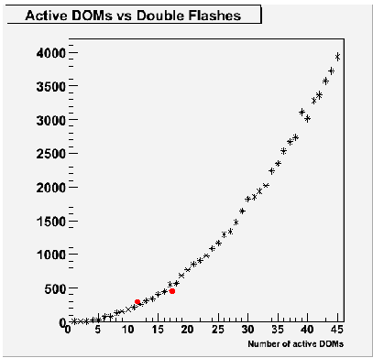
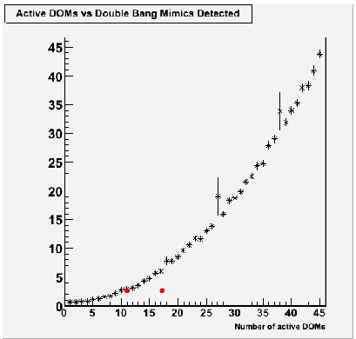
A Monte Carlo study projection of the number of expected double bang mimics
Python script models N flashing DOMs
Employs randomized distributions of flasher rates and starting times acquired from flasher data
Model reproduces data well (data points in red)
Number of double flasher events
Number of double flasher
events mimicking nutaus
Number of flashing DOMs
Number of flashing DOMs

Slide 4
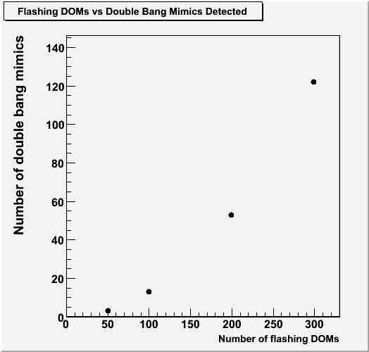
Projected number of mimics consistent with tau time-of-flight (within 10 ns)
Run length = 1100s

Slide 5
Can IceCubeHandle the Bandwidth?
Using 100-300 flashers triggers represents a potential bandwidth concern
Most of the events are single flasher events and as such will not be needed
The number of hit PMTs (nHit) provides a suitable filter for removing single flasher events
>1 DOMs produce significantly higher nHit

Slide 6
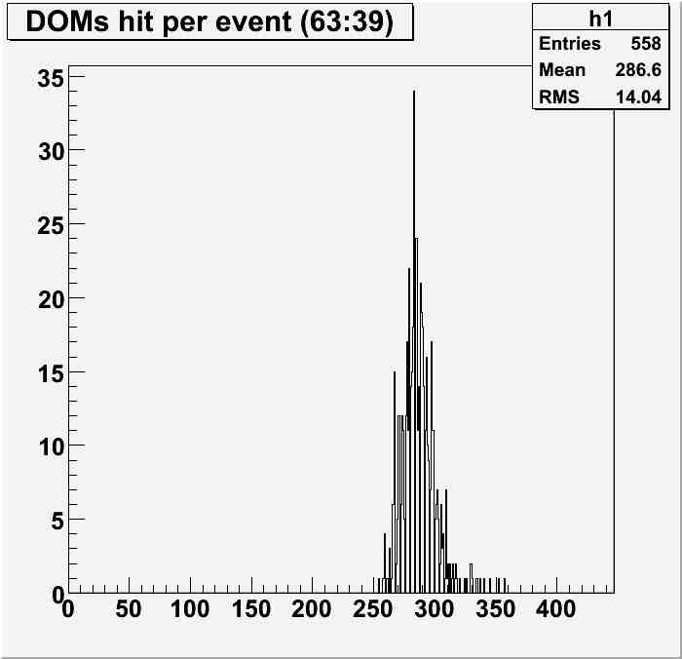
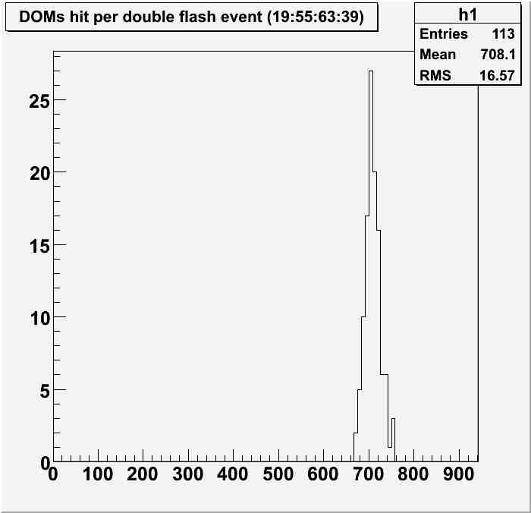
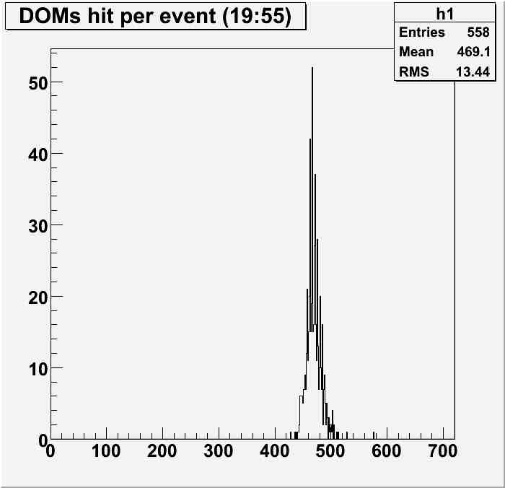

Slide 7
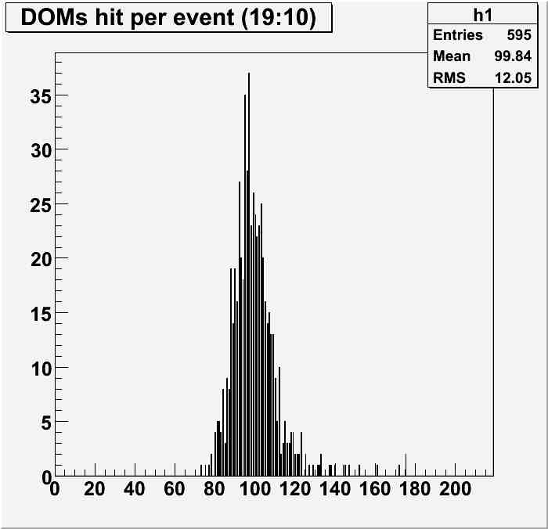
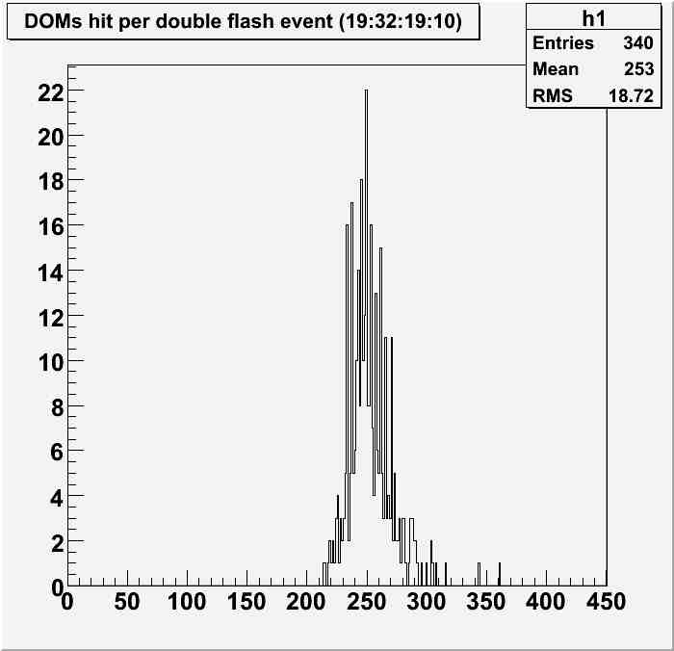
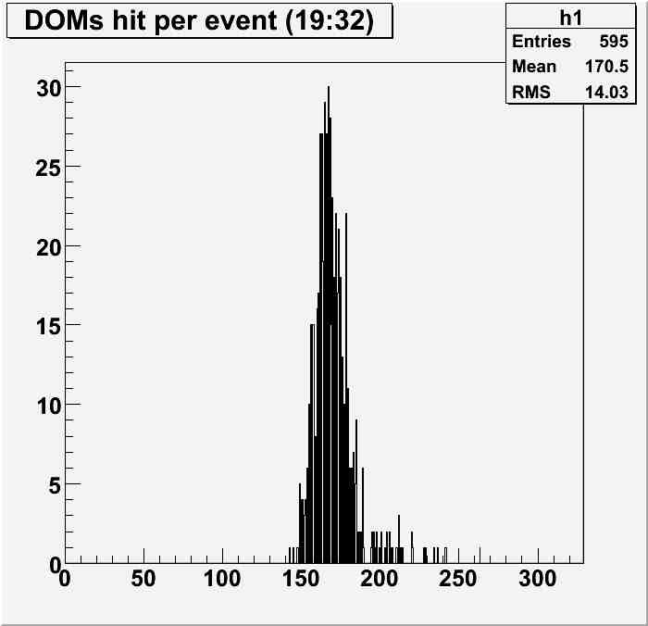

Slide 8
We looked at some possible concerns for a PMT based selection trigger
Flasher z-position choices
Avoid dust layer
Ice properties result in less light for flashers above vs. below dust layer (nHit ~ 0.6z + 200)
Flasher brightness
Flasher data used in this study had one LED flashing at maximum brightness
Could adjust flasher brightness to “balance” ice properties
MC predicts tau neutrino double bang mean nHit is ~300 DOMs for L(tau) > 50m
(Thanks to Seon-Hee and MarkD for these numbers.)

Slide 9
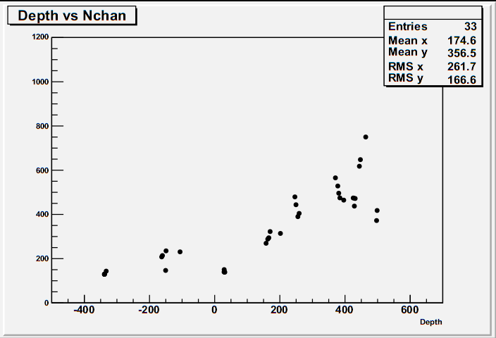
Flasher Event Multiplicity vs. Depth
Number of hit DOMs
Depth

Slide 10
Normalized flasher brightness provides a means to acquire many mimics!
Using depth vs brightness we may run a large number of flashers at single mean nHit ~100 DOMs and double mean nHit of >150 DOMs.
Mark D estimates an average nHit of ~101 over the E⁻² spectrum
300 DOMs flashing at 10 Hz results in:
~0.1 “perfect” (<10 ns error) mimic/second
~0.3 mimic/second with < 30 ns error
1.1 x 10⁻⁴ double flash events / (DOMs² second)

Slide 11
Conclusion
Useful tau neutrino double bang calibration data could be obtained by a dedicated flasher run in the near future
By ignoring events with just one flasher, the bandwidth requirement may be minimized

